Slide 1
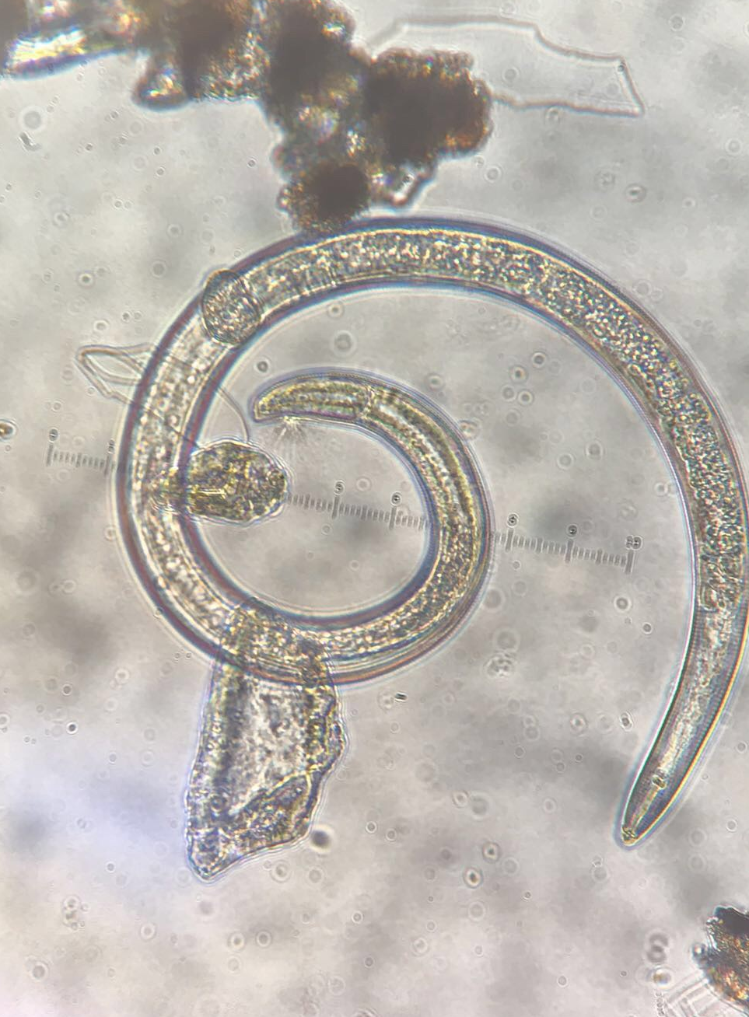



Forest Management: Are We Doing the Right Thing?
Cedric Gammon
Northern Arizona University
Mentor: Nancy Johnson

Slide 2
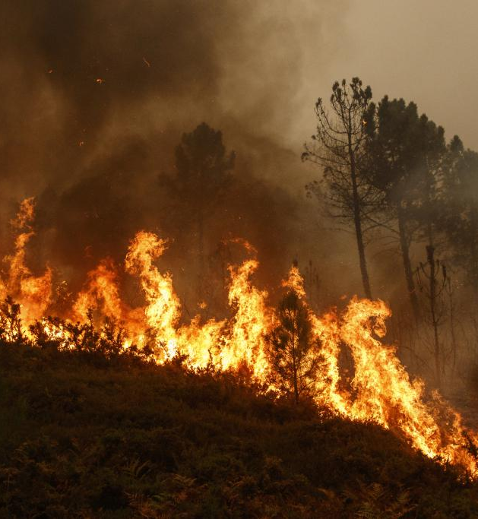
Questions
Climate change and forest management affect soil
Thinning and Burning – what are the effects on soil?
Soil biota are a great indicator of soil health
Notes:
Catastrophic fires – effect is negative?, make a diagram (plants, fungi, animals) – manipulative experiment

Slide 3
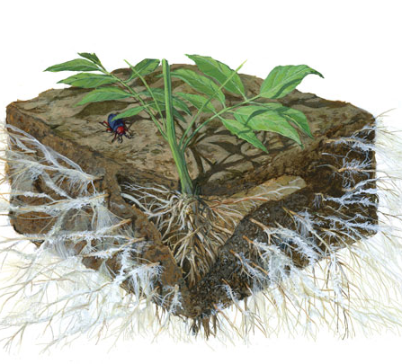
Measures of Soil Health
Mycorrhizal fungi
  Use hyphae - “fungus roots”
Nutrients
  Use nitrogen levels - ammonia (NH₃) and nitrate (NO₃-)
Decomposition rates
  Use wood (balsa) and cotton (museum board)
Mycorrhizae

Slide 4
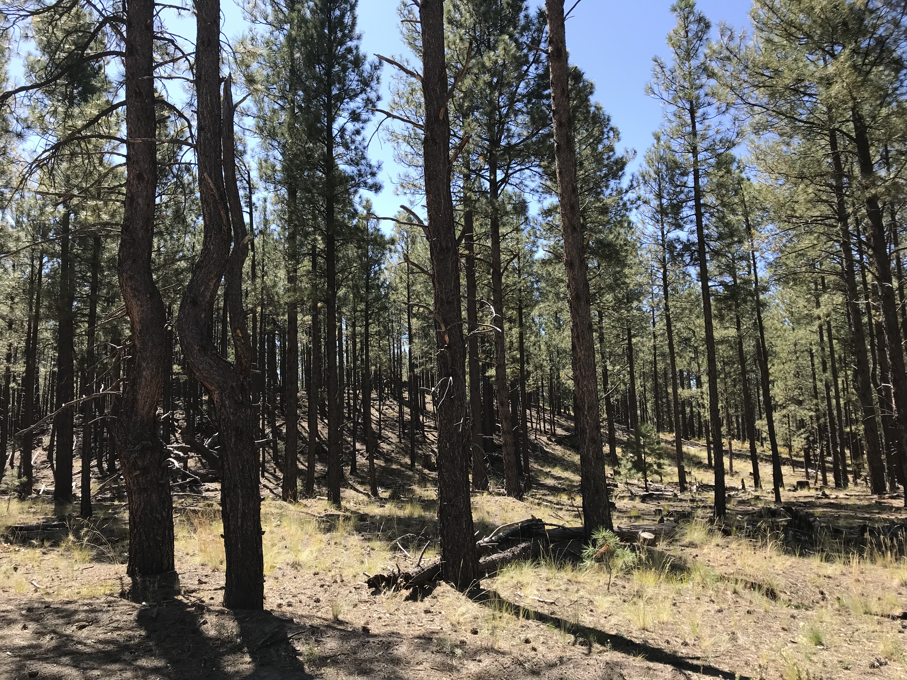
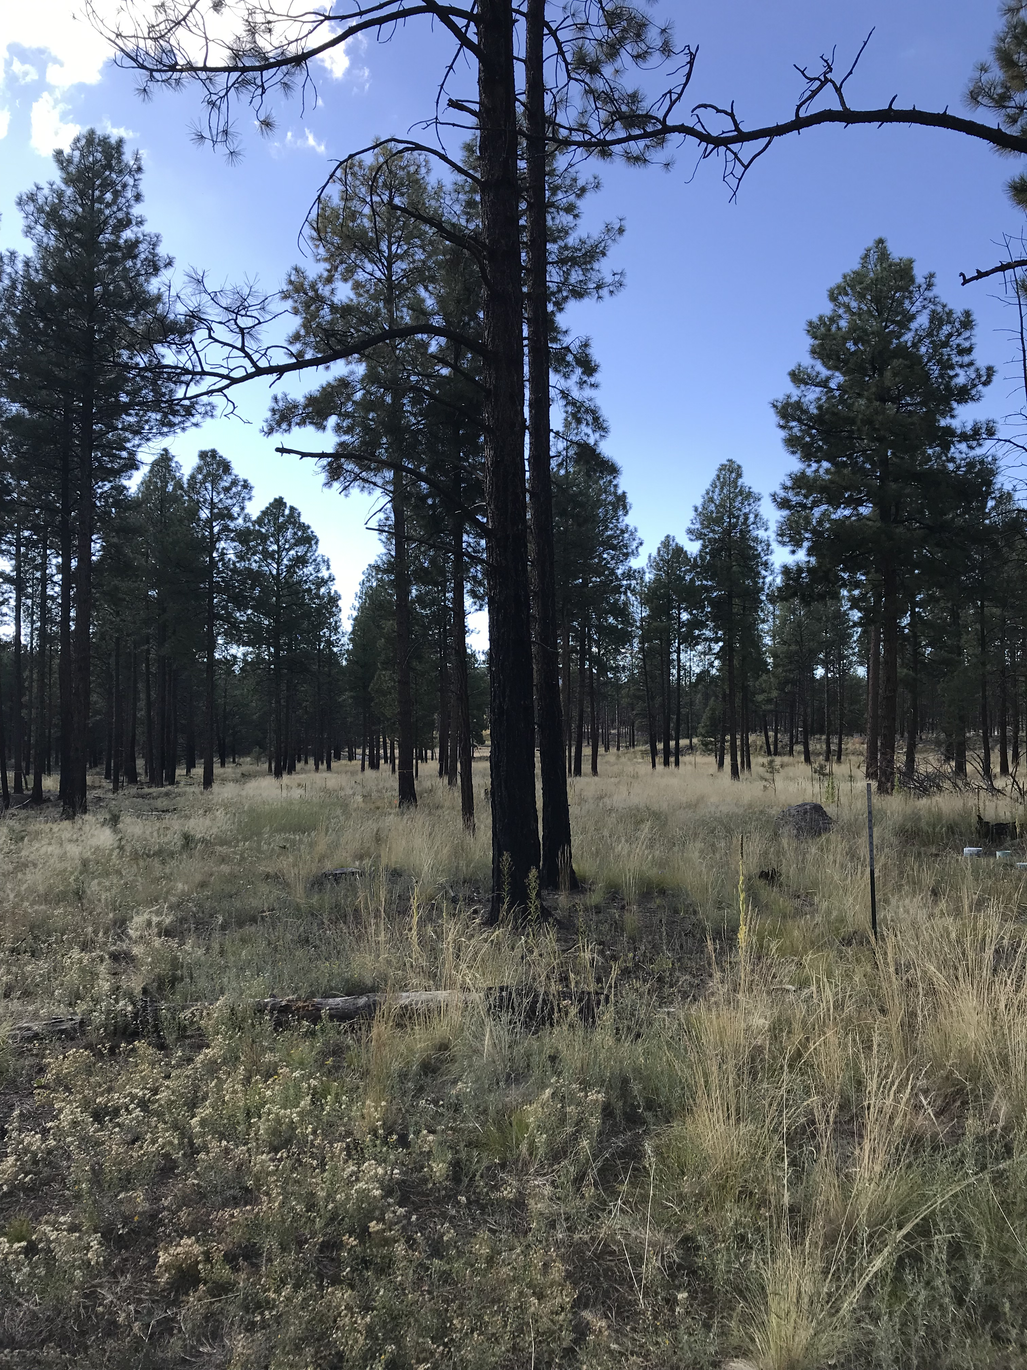
Field Site - Valles Caldera National Preserve, New Mexico
Control
Thinned and Burned
Notes:
Forest density photos

Slide 5
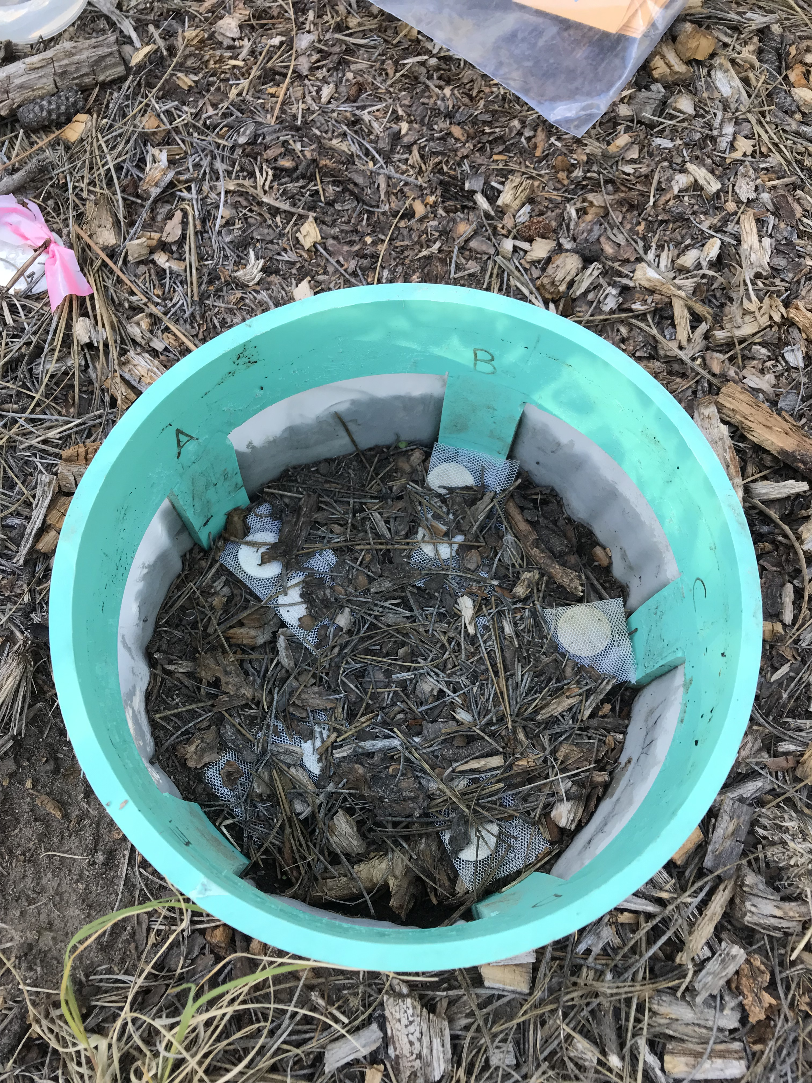
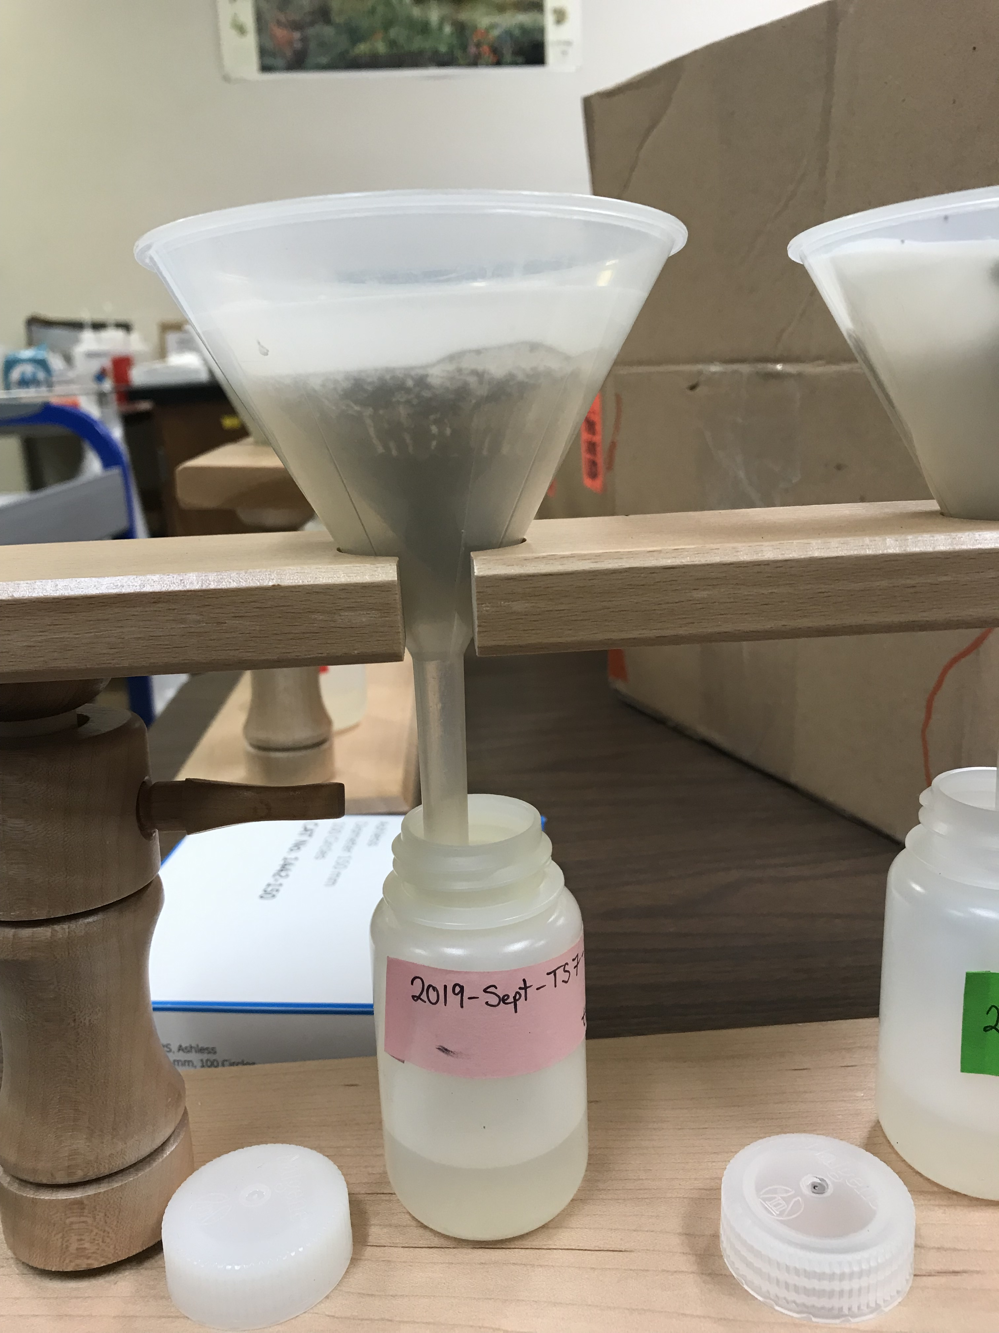
Data Collection
Mesocosms selected randomly from each treatment
Available nitrogen extractions from soil sample
Measured balsa wood and museum board before and after environment exposure
Extract hyphae
Mesocosm
Nitrogen extraction
Notes:
Mesocosms diagram TB vs. C, Kara

Slide 6
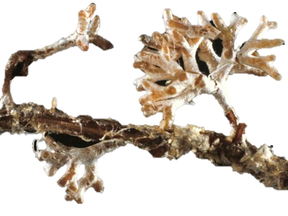
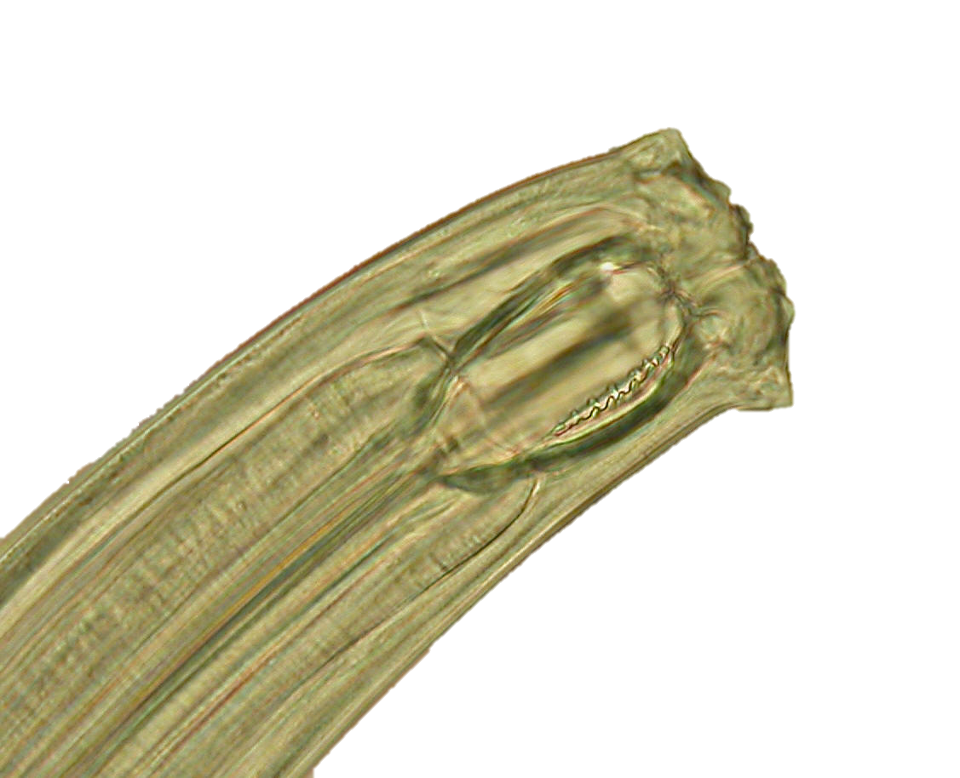
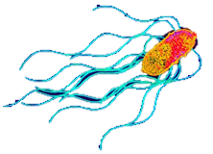
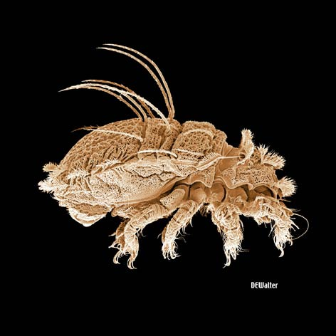
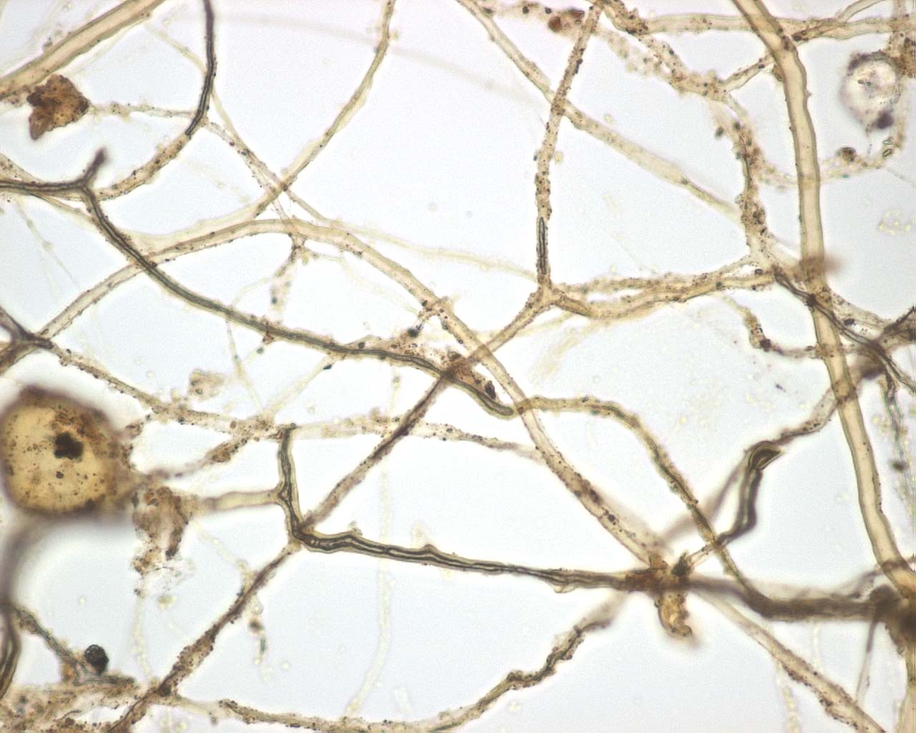
Independent Variables
Dependent Variables
Thinning
& Burning
Decomposition
Soil Biota
Mesocosm
Mesh Size
Nitrogen
Levels

Slide 7
Results - Nitrogen
Ammonia showed higher levels in control sites, nitrate tended to show higher levels in control sites

Slide 8
Results - Decomposition
Lignin decomposed faster in control, cellulose decomposition rates similar for both treatments

Slide 9
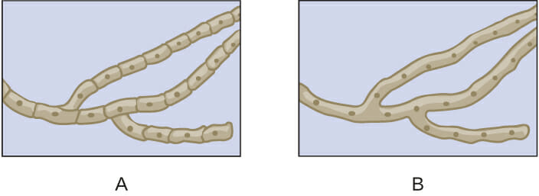
Results – Fungal Hyphae
Tended to have more arbuscular mycorrhizal hyphae in control sites, tended to have more septate hyphae in thinned and burned sites

Slide 10
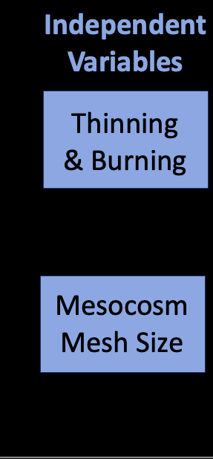
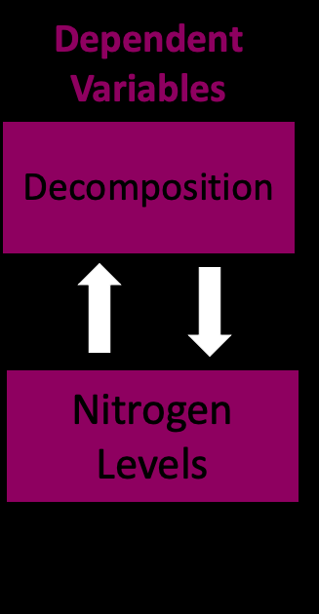
Summary
Hyphae – no conclusion
Nitrogen increased in control sites
Decomposition of lignin increased in control sites; cellulose decomposition decreased
Soil Biota
TBD
TBD
TBD
TBD

Slide 11
Acknowledgments
Thank you to the NASA Space Grant Consortium, Valles Caldera National Preserve Staff, Nancy Johnson, Anita Antoninka, Kara Gibson, and the Joint Fire Science Program, for the assistance in this research project.

